Slide 1


ALTIQ HOSPITALITY

Slide 2

PROBLEM STATEMENT
Atliq Grands owns multiple five-star hotels across India. They have been in the hospitality
industry for the past 20 years. Due to strategic moves from other competitors and ineffective
decision-making in management, Atliq Grands are losing its market share and revenue in the
luxury/business hotels category. As a strategic move, the managing director of Atliq Grands
wanted to incorporate “Business and Data Intelligence” in order to regain their market share
and revenue.
However, they do not have an in-house data analytics team to provide them with these
insights. Their revenue management team had decided to hire a 3rd party service provider to
provide them with insights from their historical data.

Slide 3


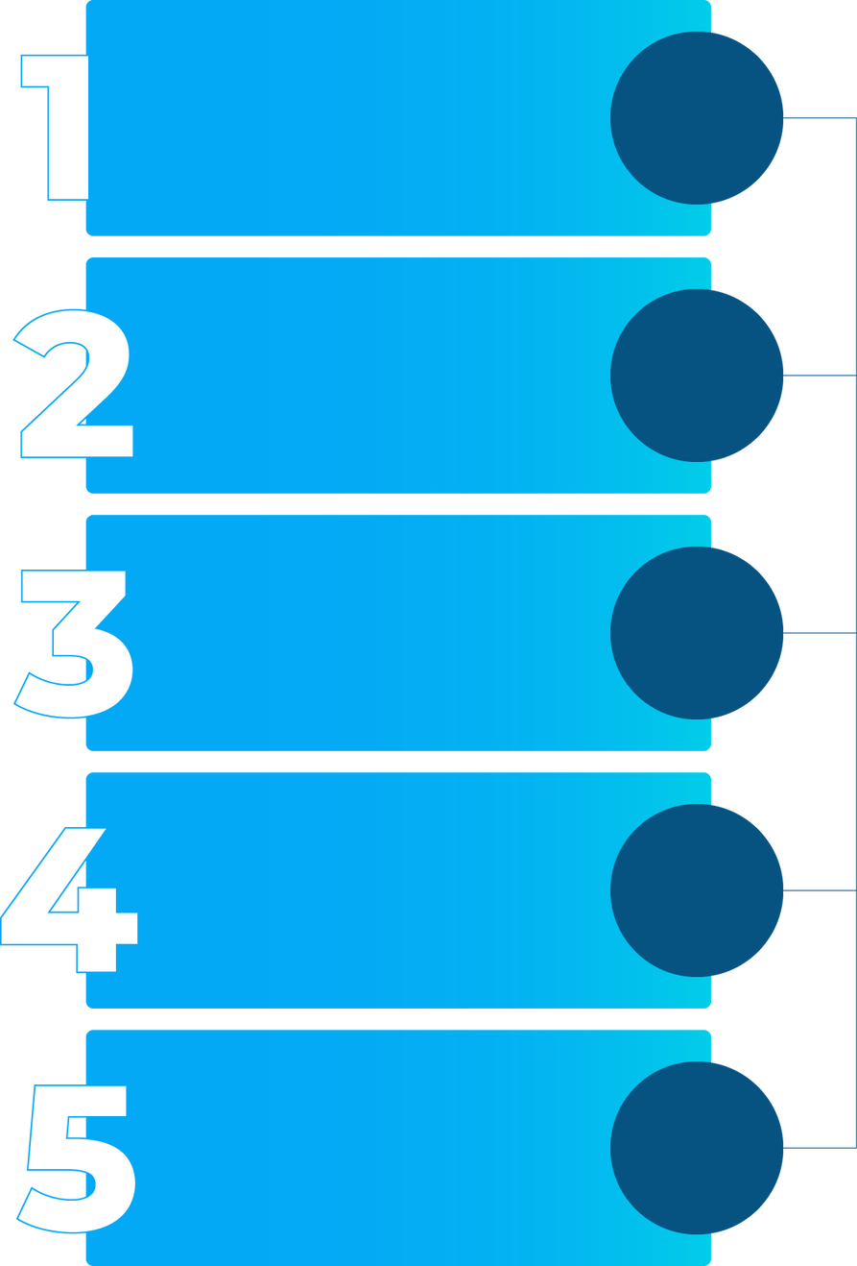
STEPS TAKEN FOR ANALYSIS
Adding necessary Columns/ measures for effective Visualisations
Establishing relationships between the fact & dimension tables
Data Visualisation
Using Microsoft
Power BI

Slide 4
ADDING NEW COLUMNS/ MEASURES
New Measure added for % utilization of room as this is an important KPI to be tracked.
New measure added to calculate % completed bookings, % of cancelled bookings and % of no shows
To get the KPI % cancellation a conditional column was first added
that check if revenue generated and revenue realized column to see if there is a cancellation. This column was then used to calculate the %cancellation
New measure added to calculate % revenue lost to analyse the segments in which cancelations were happening.
New measures called Average Daily Rate(ADR) and Revnue Per Available Room(RevPAR) were added as these are important KPIs in the hotel industry. A new measure was also added to calculate average revenue earned per hotel.

Slide 5
DEFINTION AND IDENTIFCATION OF KPIS
Total Revenue- Sum of realised revenue
Total Capacity-Sum of number of rooms in the hotel
% Utilization- Sum of successfully booked rooms/ Total capacity
% Cancellation- Sum Of cancelled rooms /Total Capacity
%Revenue Lost-(Revenue Generated-Revenue Realized)/Revenue Generated
Industry Specifc Ratios
Average Daily Rate- This indicates the average charge per room. Here it was calculated by Total Revenue Realised/ Total Successful bookings.
RevPAR- This indicates the revenue earned per all available rooms, It will be equal to ADR at 100% capacity. Here it was calculated using Total Revenue/Total Capacity.
Greater the difference between the both , it indicates inefficiencies either in filling the rooms or in pricing startegies.

Slide 6
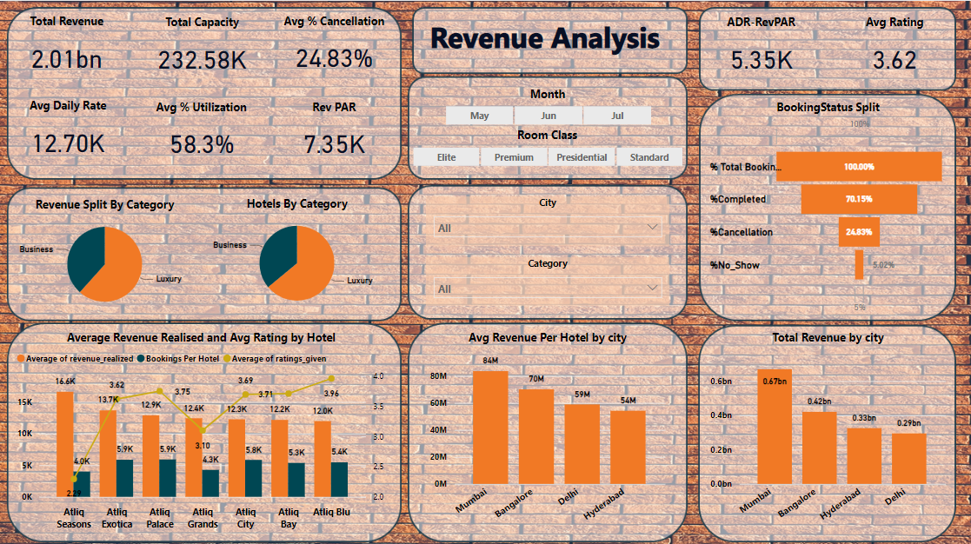
DATAVIZ USING POWERBI

Slide 7
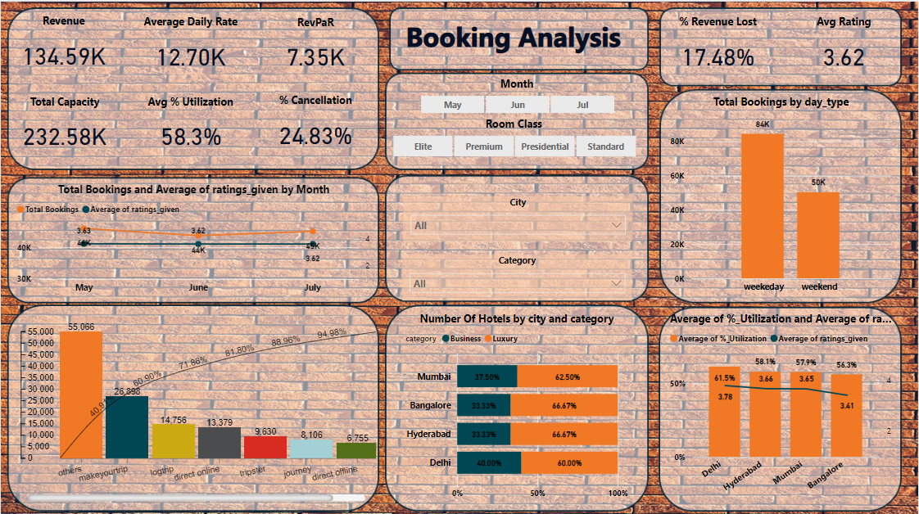
DATAVIZ USING POWERBI

Slide 8
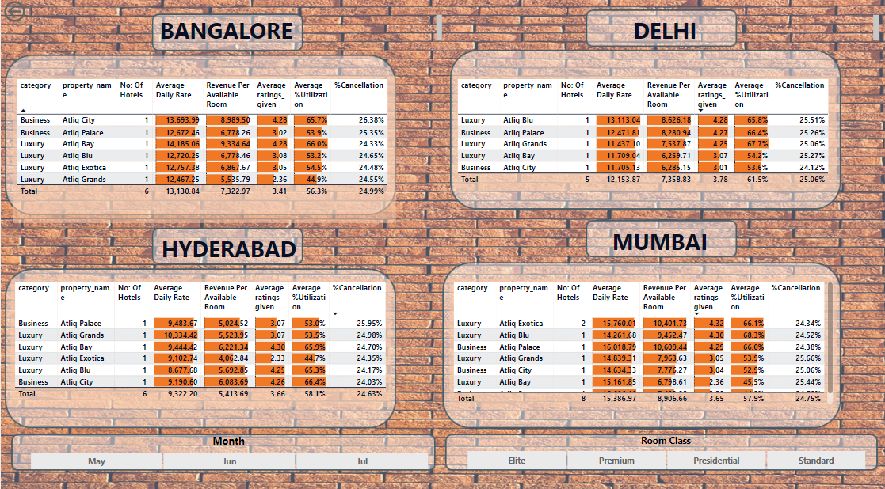
DATAVIZ USING POWERBI

Slide 9
FEATURES OF THE DASHBOARD
Separate pages to analyze revenue wise trends and booking wise trend
Modularity
City wise details given in a table format to analyze on a more deeper level the city level insights. Tables are easily interpretable by the use of bars to represent numbers for easy visual comparision
Comprehensive
Slicers and filters used all through allow customisation and interactivity
Customisation
Tooltips have been used over essential cards so that the user can hover over them to view the week wise trends of these KPIs
Ease of Use

Slide 10
INSIGHTS
Altiq Seasons group which is a business hotel has the lowest rating but earns the highest revenue in average terms inspite of having the least bookings. This possibly indicates that the rooms are overpriced which may be one of the reasons why it is rated so low.
Altiq Blu hotels earns the least revenue per hotel despite being the highest rated and having comparable number of bookings as other hotels. Given the higher rating enjoyed by these group hotels they can charge a premium especially considering that it is a premium group of hotels.It is performing well in all other cities other than Bangaore. The reason for this underperformance of the cash cow of the Altiq groups in Bangalore needs to be examined
A dip in bookings was noticed in June across categories and across cities with ratings maintaining a stable 3.6 over the same period. This indicates that the dip in revenue is seasonal and not due to any customer dissatisfaction during the time.
Altiq Seasons hotels saw the least utilization coupled with the least ratings. The company can consider selling off this property or working performance standards drastically.

Slide 11
INSIGHTS
Delhi with lesser number of hotels than Hyderabad is almost comparable revenue as Hyderabad and earns more on a per hotel basis. Analysing further using the city wise anlysis page, we notice that Delhi hotels performing better compared to other cities with better average ratings with no hotel having a rating below 3.
It also saw the highest utilization of rooms again with no hotel recording below 50% utilization across any of the periods mentioned
More than 40% of the bookings are from others platform. This is concerning since hotel as classified some platform contributing a significant portion Once this is done of income as others. They neeed to be identified as declassified from the others category. Once this is done,the pareto chart can be reconstructed to analyse which platforms the hotel chain needs to focus on.
ADR-RevPar is highest for Mubai at 6.5K indicating inefficiencies either in their pricing strategy or that their capacity is not being fully utilised. It is the least for Hyderabad at 3.9K inspite of having lower occupancy than Delhi indicating that more high value rooms are being sold IN Hyderabad than in Delhi.

